Slide 1
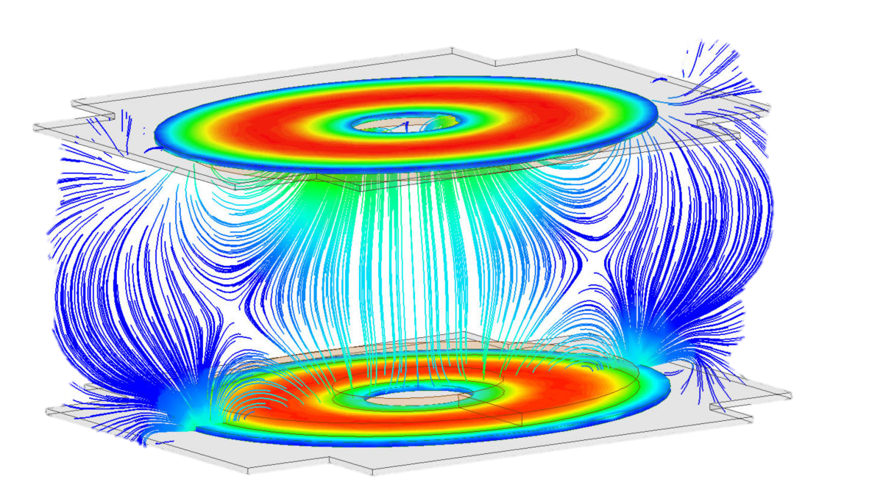
Dynamic Compensation-Impedance Matching Networks for Optimal Power Transfer Efficiency in Single-Coupling Capacitor Wireless Power Transfer (SCC-WPT) Using Software Defined Networking (SDN) https://drive.google.com/file/d/1r09Q2MQRn-wbHBTds9rorl9I3w3JtOd8/view?usp=sharing Mahamoud Howaidi 04/17/2023

Slide 2
Introduction
Purpose : This project proposes to design, implement, and simulate a single coupling capacitance wireless power transfer and show the effects of changing the distance between the transmitter plate and receiving plate, which affects the magnitude of coupling capacitance between the plate, in turn, used to tune the compensation circuit parameter.
Objectives : This project aims to ensure that the system efficiently delivers maximum constant power to the load (receiver), even if the distance between the plates changes. Moreover, it shows a high noise effect on the communication between the transmitter and the receiver plate and how this noise can change the coupling capacitance value.
The motivation behind using single coupling capacitance WPT is to overcome the limitations of conventional wired power transfer methods, which require bulky cables and connectors prone to wear and tear over time.

Slide 3
Literature Review
Capacitive Wireless Power Transfer utilizes electric field coupling between conductive plates. This technology enables power transfer through metal barriers and potentially offers low Electromagnetic Interference (EMI) and low power losses with simple coupling configurations [1, 2]
Extensive research articles on CWPT technology have been carried out in the past few years, including compensation network, coupling structure, parameter design and optimization, modeling, and dynamic analysis [3], [4], [5], [6]. Most previous studies focus on conventional CPT systems, which require two pairs of metal plates to complete the circuit loop to transfer power from a power source to the load.
The research on the SCC-WPT technology is still in the early stages, so only a few papers have been reported in the literature. The coupling plate could be reduced by connecting directly or equivalently short-connected [7], [8]. However, the system power could be transferred to a load when the secondary side dangles. Neste et al. [9] proposed a method that delivers power through the resonance of a helical receiver with its surrounding stray capacitance, corresponding to an explanation based on reflection theory.
An SCC-WPT system with double LCLC compensation topology has been proposed in [24], and the system achieved a 3.8 W output power with an efficiency of 32%. In [10], based on the self-capacitance theory, two big metallic balls were adapted to form a circuit loop to enhance the system’s performance. The system achieves a 20 W power transfer with an efficiency of 53.4%. In [11], a simple model of a single-wire CPT system was built based on the coupling to the ground.
Unlike IPT technology, which has been applied in many fields and has many successfully commercialized products [12], [13], [14], the CPT technology provides advantageous features, such as lightweight, low-cost coupling structures, flexibility in coupling structure design, the ability to transfer power across metal barriers, and low eddy-current losses in the surrounding metallic objects [15], [16], [17].
The coupling capacitance is sensitive to the area of overlap of the two plates and the air gap between the plates, which means that any slight misalignment between the two coupling plates will cause a significant variation in the total coupling capacitance. These matters seriously affect the power transfer performance of SCCWPT systems [18-20].

Slide 4
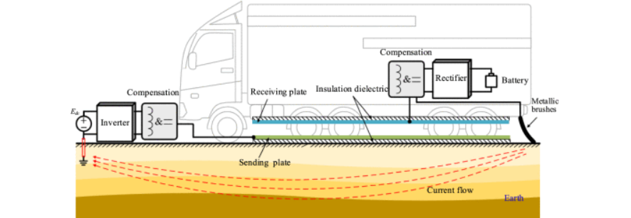
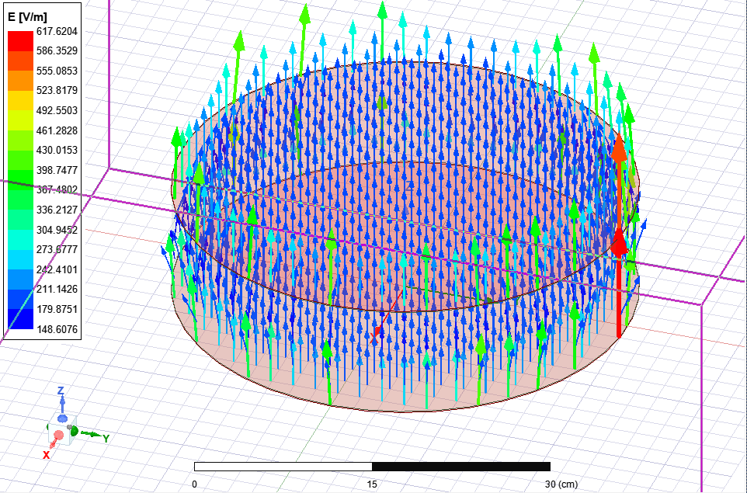
Methodology
Because Matlab cannot calculate the capacitance between two plates and take a fixed value to the capacitor, we should use a finite element program to show the effect of changing the distance between the plates, which can do it using ANSY.
As shown in the figure 2, a simulation model built for the two plates (the first one mounted on the street and the other mounted under the vehicle). After that, an Excel sheet was produced to show the capacitance value corresponding to each distance.
In Matlab, a simulation was built to show the inverter, rectifier, and the load (vehicle battery) connected through coupling capacitance (the coupling capacitance value depends on the distance between the plates).
Now if the distance between the vehicle and the street change for any reason, the value of the Cc will change, and the power transfer to the battery will change too. However, by using a communication system between the plates, we can adjust the value of the compensation parameter to ensure a fixed power transfer to the load.
Figure 1 Single Coupling Capacitor Wireless Power Transfer.
Figure 2 ANSYS simulation for two plates.

Slide 5
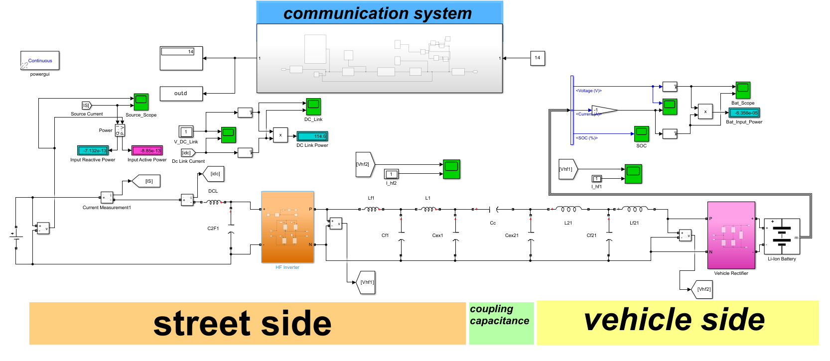
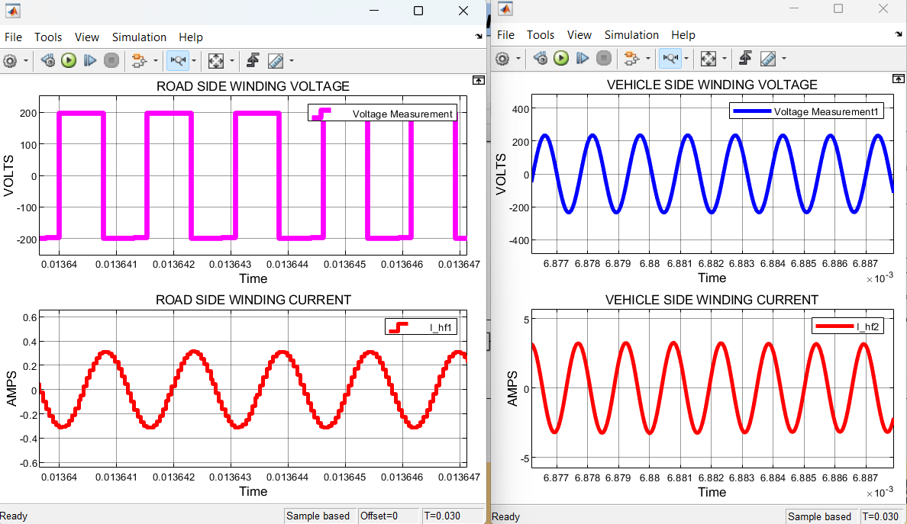
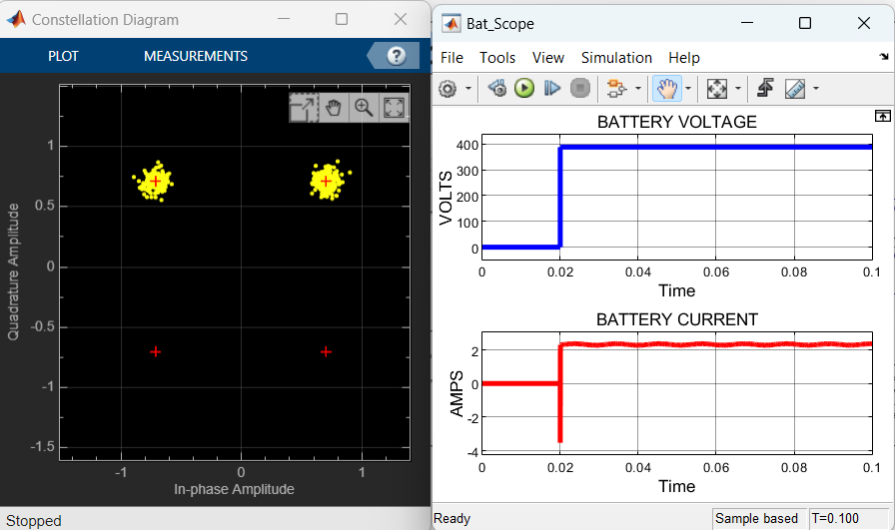
* The figures show a constant voltage and current delivered to the battery through Coupling capacitance from a DC voltage source. * The communication system transmits the exact value for the distance between the plates because the noise has a minimum value. However, the distance may change if the noise is more significant, affecting the Cc magnitude.
Results and analysis

Slide 6
Discussion
Using this method to charge electric vehicles' batteries, a constant voltage and current will deliver to the battery, which has many benefits:
Constant voltage and current charging methods are designed to ensure that the battery is charged to maximize its lifespan. This is achieved by carefully controlling the charging rate and the maximum charging voltage, which can help minimize the stress placed on the battery cells. Over time, this can help extend the battery's lifespan, an essential consideration for electric vehicles.
Charging speed: By carefully controlling the charging rate, constant voltage, and current, charging methods can help to ensure that the battery is charged as quickly as possible without causing damage to the cells. This is important for electric vehicles, which need to charge quickly to provide a convenient and practical alternative to traditional gasoline-powered vehicles.
This project uses a single coupling capacitance to connect the transmitter side and receiving side instead of conventional coupling capacitance, which needs four plates (two plates for each side). There is a trade-off between the two methods, We sacrificed making the value of Cc smaller, but we benefited from reducing the system's size and the cross-coupling between the plates.
The communication process used in this project must have many characteristics, such as the speed of information transfer and the ability to return the correct distance that was transmitted, even with high noise in the system.

Slide 7
Conclusion
In this project, we suppose that the distance between the receiver and transmitter plate can be perfectly calculated, and this distance does not change regardless of the situation of the street.
Another limitation is if the distance suddenly changes for any reason, the transmitted distance will be changed, and the coupling capacitance value may go to zero, leading to zero power transfer to the load. In this project, we discard the noise that comes from other car communication for the same system, which may lead to the transfer wrong distance to the transmitter side, affecting the compensation parameter magnitude.
These problems can be solved by good design for the communication system, and if the distance changes, keep a minimum value of power transfer.
In the future, a model for multi-load with a single transmitter plate can be used to charge a multi-car battery simultaneously by using different compensation circuits with perfect insulation between the compensations to prevent cross-coupling between the parameters.

Slide 8
Acknowledgments
I would to thank Dr. Yousef and Dr. Billy for valuable information about every part of the project.

Slide 9
Reference
[1] C. Liu, "Fundamental Study On Capacitive Coupled Power Transfer Technology," PhD thesis, Department of Electrical and Computer Engineering, University of Auckland, Auckland, 2011.
[2] W. R. Wilson, l. G. C. Robertson, J. L. Zwi, and B. V. Dawson, "Health Effects of Sinusoidal 10 kHz Magnetic Fields," 20 December 1993.
[3] Y. Wang, H. Zhang, and F. Lu, “Capacitive power transfer with seriesparallel compensation for step-up voltage output,” IEEE Trans. Ind. Electron., vol. 69, no. 6, pp. 5604–5614, Jun. 2022.
[4] Y. Liu, T. Wu, and M. Fu, “Interleaved capacitive coupler for wireless power transfer,” IEEE Trans. Power Electron., vol. 36, no. 12, pp. 13526–13535, Dec. 2021.
[5] J. Xia, X. Yuan, S. Lu, J. Li, S. Luo, and S. Li, “A two-stage parameter optimization method for capacitive power transfer systems,” IEEE Trans. Power Electron., vol. 37, no. 1, pp. 1102–1117, Jan. 2022.
[6] L. Li, Z. Wang, F. Gao, S. Wang, and J. Deng, “A family of compensation topologies for capacitive power transfer converters for wireless electric vehicle charger,” Appl. Energy, vol. 260, 2020, Art. no. 114156.
[7] F. Lu, H. Zhang, and C. Mi, “A two-plate capacitive wireless power transfer system for electric vehicle charging applications,” IEEE Trans. Power Electron., vol. 33, no. 2, pp. 964–969, Feb. 2018.
[8] X. Gao et al., “Design and analysis of a new hybrid wireless power transfer system with a space-saving coupler structure,” IEEE Trans. Power Electron., vol. 36, no. 5, pp. 5069–5081, May 2021.
[9] C. W. V. Neste et al., “Single-contact transmission for the quasi-wireless delivery of power over large surfaces,” Wireless Power Transf., vol. 1, no. 2, pp. 75–82, 2014.
[10] X. Gao, H. Zhou, W. Hu, Q. Deng, G.-P. Liu, and J. Lai, “Capacitive power transfer through virtual self-capacitance route,” IET Power Electron., vol. 11, no. 6, pp. 1110–1118, 2018.
[11] L. J. Zou, Q. Zhu, C. W. Van Neste, and A. P. Hu, “Modeling singlewire capacitive power transfer system with strong coupling to ground,” IEEE J. Emerg. Sel. Topics Power Electron., vol. 9, no. 2, pp. 2295–2302, Apr. 2021.
[12] T. Feng, Z. Zuo, Y. Sun, X. Dai, X. Wu, and L. Zhu, “A reticulated planar transmitter using a three-dimensional rotating magnetic field for free-positioning omnidirectional wireless power transfer,” IEEE Trans. Power Electron., vol. 37, no. 8, pp. 9999–10015, Aug. 2022.
[13] X. Hou, Y. Su, Z. Zuo, X. Dai, and Y. Fei, “A novel analysis method based on quadratic eigenvalue problem for multirelay magnetic coupling wireless power transfer,” IEEE Trans. Power Electron., vol. 36, no. 9, pp. 9907–9917, Sep. 2021.
[14] W. Zhong and S. Y. R. Hui, “Charging time control of wireless power transfer systems without using mutual coupling information and wireless communication system,” IEEE Trans. Ind. Electron., vol. 64, no. 1, pp. 228–235, Jan. 2017.
[15] W. Liu et al., “A multi-load capacitive power transfer system with loadindependent characteristic for reefer container application,” IEEE Trans. Power Electron., vol. 37, no. 5, pp. 6194–6205, May 2022.
[16] J. Dai, S. S. Hagen, and D. C. Ludois, “High-efficiency multiphase capacitive power transfer in sliding carriages with closed-loop burst-mode current control,” IEEE J. Emerg. Sel. Topics Power Electron., vol. 7, no. 2, pp. 1388–1398, Jun. 2019.
[17] W. Zhou, Q. Gao, R. Mai, Z. He, and A. P. Hu, “Design and analysis of a CPT system with extendable pairs of electric field couplers,” IEEE Trans. Power Electron., vol. 37, no. 6, pp. 7443–7455, Jun. 2022.
[18] A. Kumar, S. Pervaiz, C.-K. Chang, S. Korhummel, Z. Popovic, and K. K. Afridi, "Investigation of power transfer density enhancement in large air-gap capacitive wireless power transfer systems," presented at the Wireless Power Transfer Conference (WPTC), 2015.
[19] C. Liu, A. P. Hu, and M. Budhia, "A Generalized Coupling Model for Capacitive Power Transfer Systems," in IECON 2010 - 36th Annual Conference on IEEE Industrial Electronics Society, 2010, pp. 274-279.
[20] L. Huang and A. P. Hu, "Defining the mutual coupling of capacitive power transfer for wireless power transfer," Electronics Letters, vol. 51, pp. 1806-1807, 2015.

Slide 10
Additional materials
This is the Matlab files for the project and the Excel sheet for the capacitance vs. the distance from ANSYS electronic desktop software and the code for calculating the compensation parameter.
https://drive.google.com/file/d/12JRrEstWVPk75wAta7zC4wbccmc-UQ-u/view?usp=sharing,
https://drive.google.com/file/d/1cpZdo4L9ZBXzQGQ2lbAvhEMXOjVjieQD/view?usp=sharing,
https://drive.google.com/file/d/1jCDgziFte4e4ir-YdhqH-Rv5n6SYaPXf/view?usp=sharing,
https://drive.google.com/file/d/1mltkytj2ibOZG7DzOdSRqqkNb-AnX-se/view?usp=sharing

